Slide 1
Guide to Data and Information Sharing Workflows Across the Life Cycle of Transportation Assets
August, 2016

Slide 2
Outline
Project state
Draft Process Map, ERs and ER matrix
Work plan

Slide 3
Project state
Process maps:
Draft PM of sign new construction/reconstruction
Draft PM of sign replacement
Draft PM of sign maintenance
Exchange Requirements (ERs) and ER matrix
Draft ERs for 07 identified exchange scenarios
Draft ER matrix

Slide 4
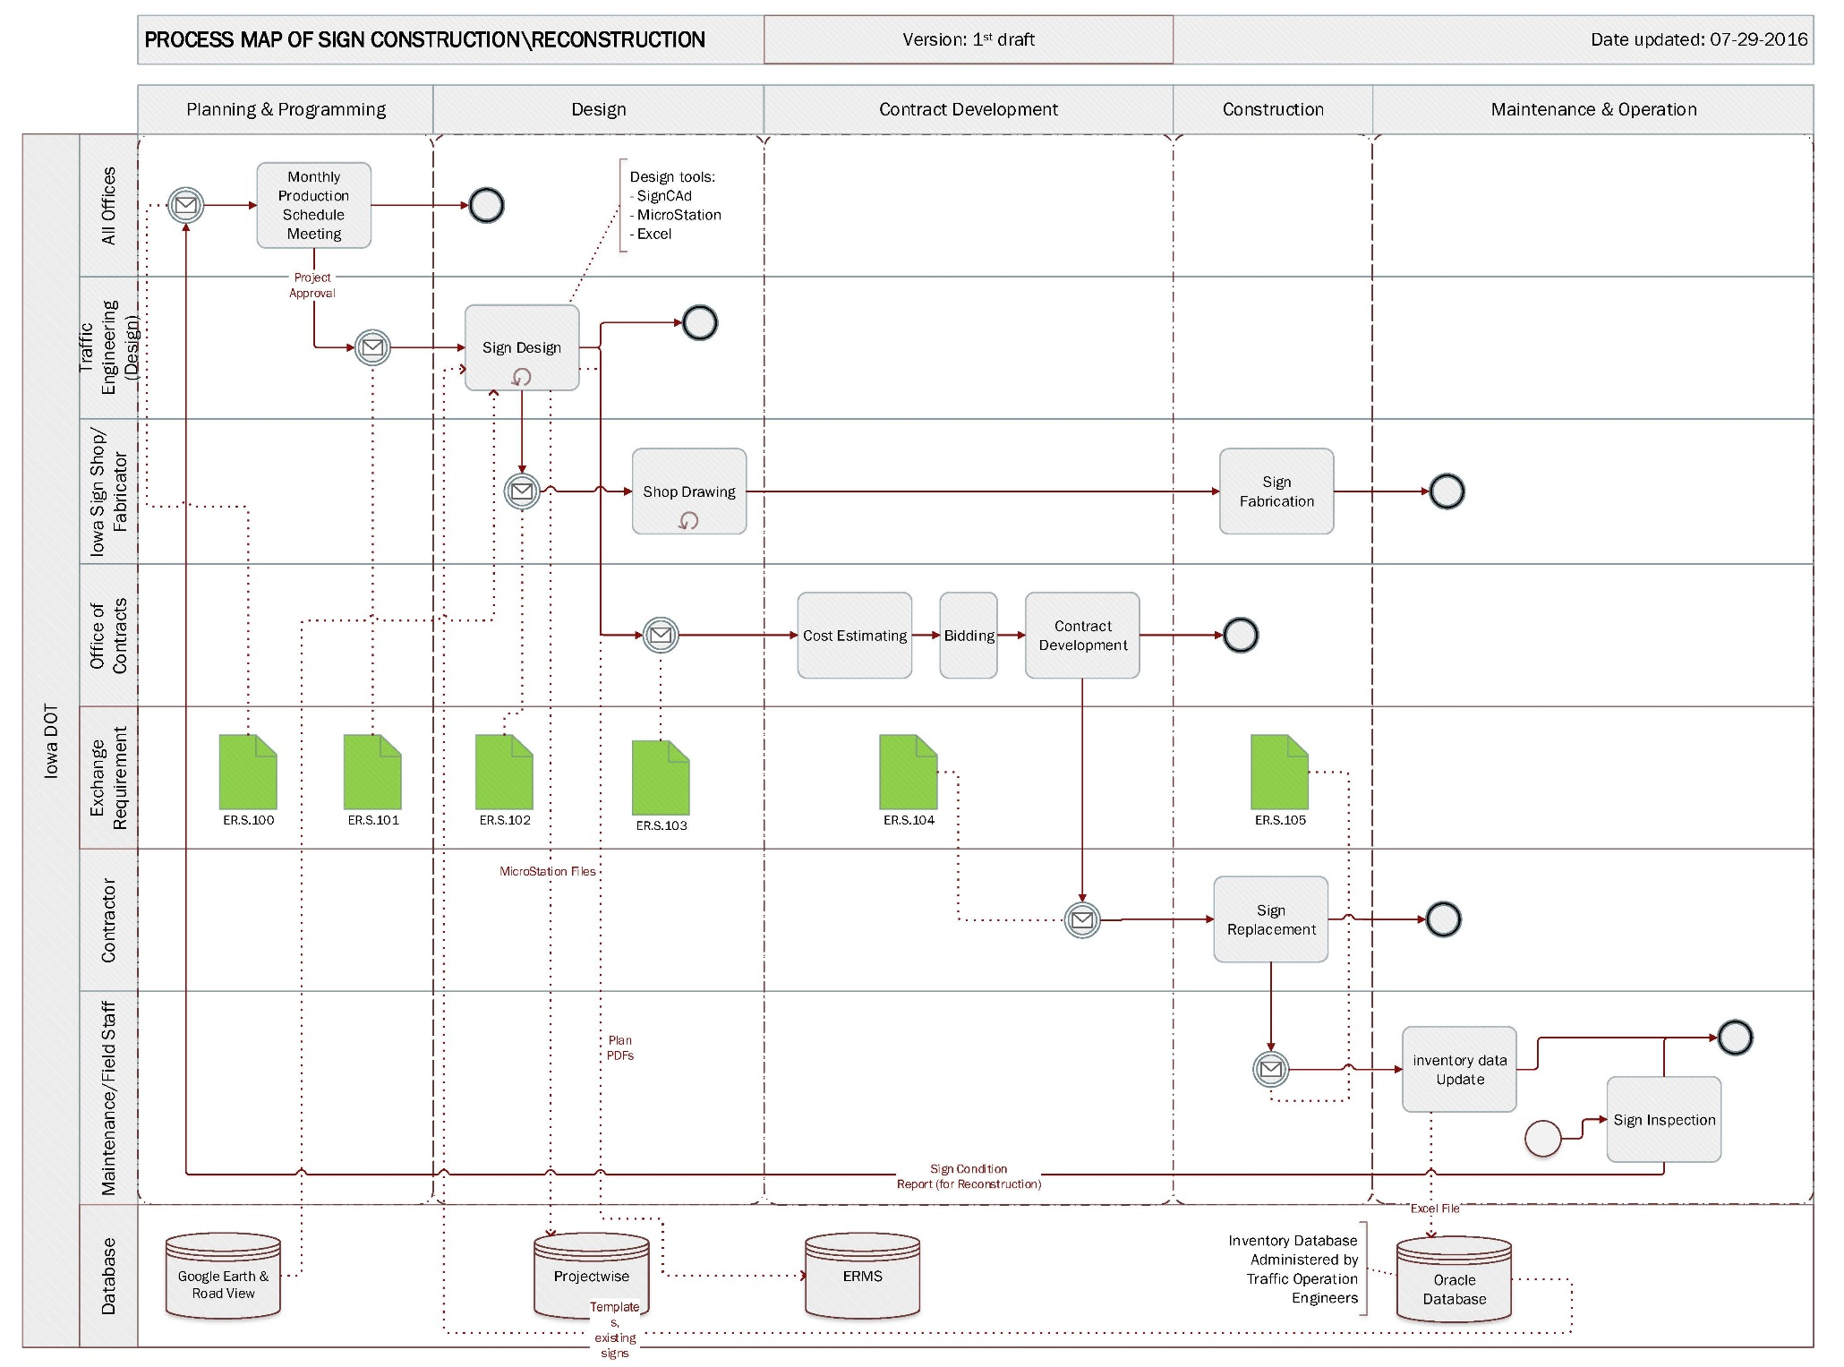
Process map
PROCESS MAP
Phase
Task
Actor
ER
Database

Slide 5
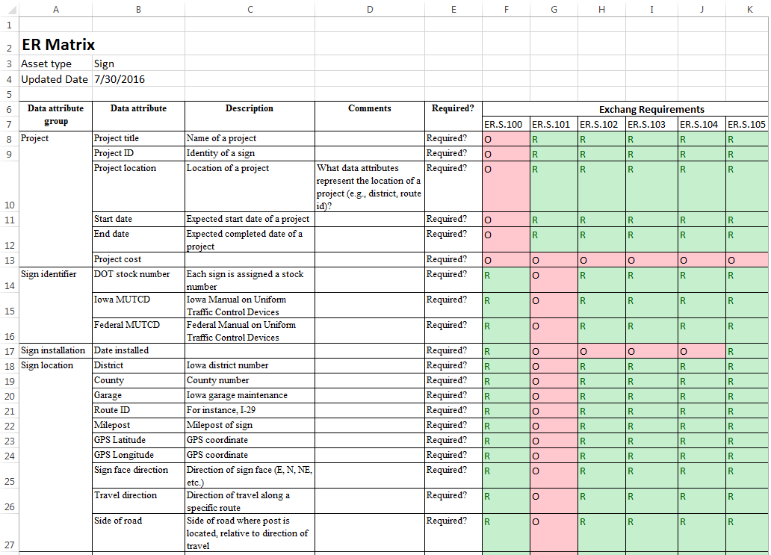

ER Matrix
Data Attributes
ERs

Slide 6
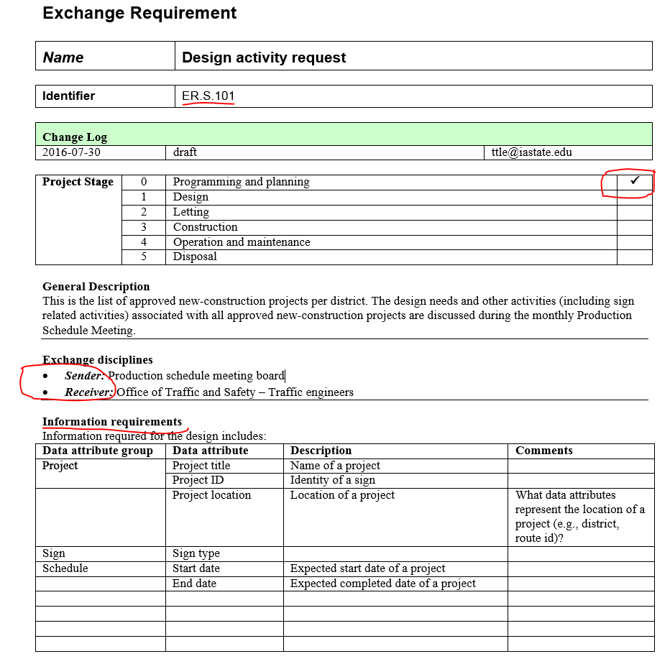
Detailed Exchange Requirement
Information included in an ER
Project phase
Data sender
Data receiver
Data required

Slide 7
Work plan
Revise PM, ERs and ER matrix based on feedback from Iowa DOT
Develop preliminary process map for guardrails
Schedule individual meetings for guardrails

